Slide 1
Celebration Text Features

Slide 3
Ivrea, Italy: The Battle of Oranges The origins of this festival are not well understood, particularly because oranges do not grow in the Alps of Italy, where the town is located. One legend has it that the Battle commemorates a popular rebellion of the 13th century, when the local poor deemed the largess of their feudal lord as inadequate, and threw it back in his face.

Slide 4
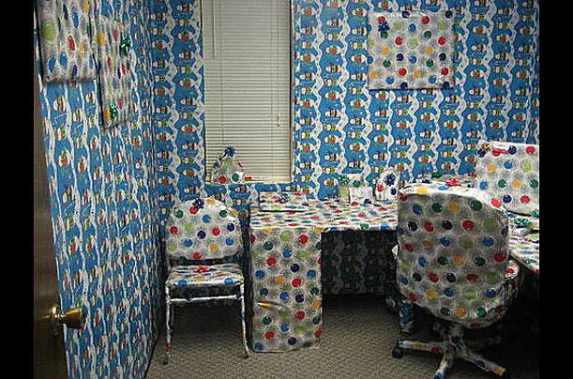

Slide 5
Employees gift wrap the boss’s office.

Slide 7
Brockworth, England: Cheese Rolling Festival In a dangerous tradition dating back to Roman times, competitors from all over the world run up a hill and then chase a 7 kg round cheese back down. The first who gets to it, keeps it.

Slide 8
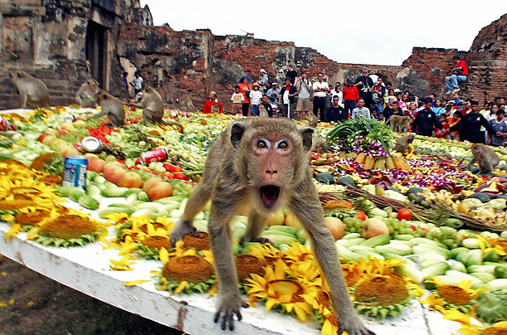

Slide 9
Lopburi province, Thailand: The Monkey Buffet Organizers of the annual monkey buffet use more than 3,000 kg of fruits and vegetables for the festival.

Slide 11
Nobsa, Colombia: International Poncho Day
Designed to promote the work of local artisans who weave traditional wool ponchos, the parade and festival are a relatively new celebration.

Slide 13
Bunyol, Spain: Tomatina
In late August, thousands of people pelt each other with over 250 lbs. of tomatoes in a span of 60 minutes in an event modestly described as the world's largest tomato fight.

Slide 14
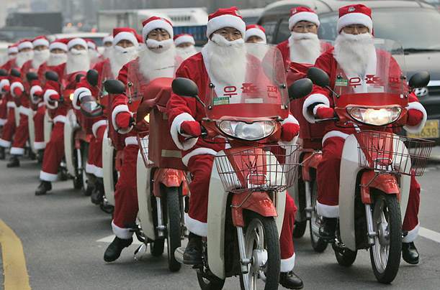

Slide 15
Seoul, Korea
Korean postmen drive away on their delivery bikes for a gift-giving event at the Central Post Office.

Slide 17
Siliguri, India School children wearing Santa Claus masks work in their classroom.

Slide 18
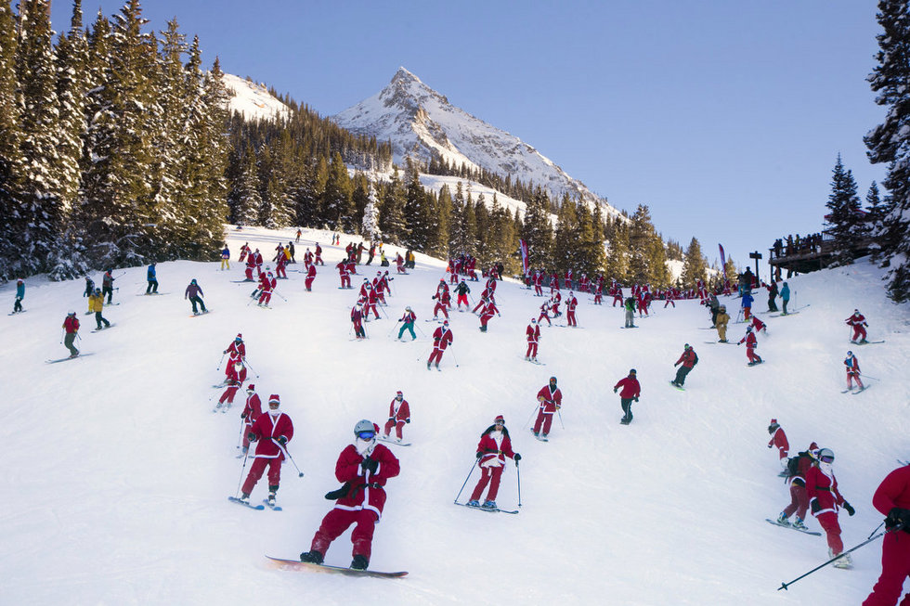

Slide 19
Photo Credits
These photos came from these photo essays:
http://content.time.com/time/photogallery/0,29307,1697456_1508640,00.html
http://photos.oregonlive.com/photo-essay/2013/12/joyous_christmas_and_holiday_s.html

